Slide 1
THE ROLES OF GOVERNING COUNCILS IN THE ADMINISTRATION OF COLLEGES OF EDUCATION IN NIGERIA
BY
PROFESSOR BAPPA-ALIYU MUHAMMADU
THE EXECUTIVE SECRETARY
BEING A PAPER DELIVERED AT THE INAUGURATION AND RETREAT FOR GOVERNING COUNCILS OF FEDERAL COLLEGES OF EDUCATION, ABUJA 25TH – 26TH MAY, 2017

Slide 2
1.0 Retreats are part of human design to get man closer to nature, for solitude, to unplug from our everyday activities and to create a new you. This retreat therefore is designed to acquaint members with the dynamics of our tertiary institutions administration. The retreat is also aimed at familiarising you with the relevant rules and regulations that are in operation in Colleges of Education system. Having noted this, I therefore wish to congratulate you on your well-deserved appointments. I have no doubt that at the end of your tenures, teacher education would have been moved to a height comparable with any part of the globe.

Slide 3
2.0 THE ENABLING LAW
There are currently twenty one (21) Federal Colleges of Education. These Colleges are governed by the following Acts:
Federal Colleges of Education Act No. 4 of 1986; and
Federal Colleges of Education Amendment Act No. 6 of 1993.
The primary focus of Colleges of Education is the production of teachers for basic education level in Nigeria. Each Council therefore is empowered by its enabling law to “hold examinations and grant diplomas, professional certificates and other distinctions to persons who have pursued a course duly approved and accredited by the National Commission for Colleges of Education (NCCE)”. The programme leading to the award of the Nigeria Certificate in Education (NCE) is usually three years duration. No student is allowed to spend more than five (5) years for the award of NCE.

Slide 4
3.0 GOVERNANCE STRUCTURE IN FCES
Below is the governance structure operated in Federal Colleges of Education:

Slide 5
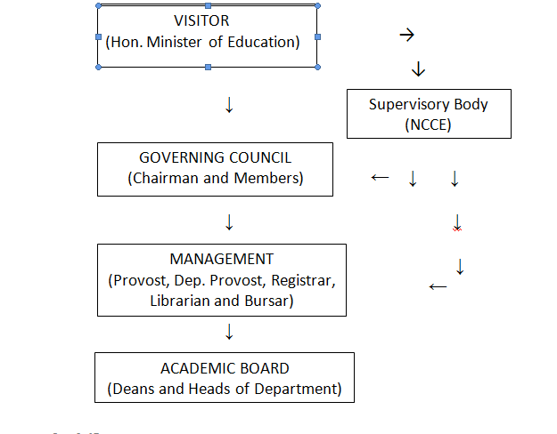

Slide 6
THE VISITOR: The Visitor is the Honourable Minister of Education. He is not a member of the institution. He acts as the link between Government and the institution. He attends convocation ceremonies and directs the five yearly visitations.
THE GOVERNING COUNCIL: This is the highest governance body of the College. It oversees the activities of the institution.
THE MANAGEMENT: This organ ensures that day to day administration of the College.
THE ACADEMIC BOARD: The Board is responsible for the directing and management of all academic matters in the College.
THE NATIONAL COMMISSION FOR COLLEGES OF EDUCATION (NCCE): The Commission perform general oversight functions, prescribe Minimum Standards in academic issues, ensure quality control, efficient and effective management and financial resources.

Slide 7
4.0 FUNCTIONS OF THE GOVERNING COUNCILS
The Governing Councils are policy making organs. Their functions amongst others include the following:
Play a general supervisory role over the administration of the institutions;
Serve as bridge between the government and the institution;
Protects the right of all in the College;
Ensure compliance to Government rules and policies;
Exercise general control over the finances of the institutions and ensure accountability;

Slide 8
Ensure judicious utilization of resources in accordance with government approved guidelines;
Responsible for the appointment of all senior staff through the appropriate Committees;
Approve budgets of the institutions, and ensure institutions solvency;
Act as the judge to alternative dispute resolutions mechanisms to ensure stable Academic calendar and crises free environment;
Serve as a link between the institutions and their communities;
Be the custodian of all assets of the institutions and exercise oversight functions on the activities of the institution;
Have a general control over the character of the institution including approval/review of mission statements and strategic plans with the general guidelines of government or relevant supervisory agencies;
Oversee the establishment of educational programmes in the institutions in accordance with guidelines given by the relevant supervisory agency;
Act as liaison between the institution and the visitor; and
Connect the public and private sector, legislature etc to garner financial support or political sympathy on related issues that will assist the College.

Slide 9
5.0 WORKING TOOLS OF GOVERNING COUNCILS
In other to ensure fairness, accountability, probity, good decision making and sound judgement, the Governing Council Chairmen and Members should keep abreast with the following working instruments:
The Nigerian Constitution;
The Enabling laws: Act No. 4 of 1986; Act No. 6 of 1993; PENCOM Act; 2007 Public Procurement Act; etc;
Conditions and Schemes of Service for Colleges Education in Nigeria;
The Public Service Rules;
Government Financial Regulations;
The Accounting Manuals; and
Extant Government Circulars; etc.

Slide 10
6.0 GENERAL ADVICE
It is worthy for all Council Chairmen and Members to note that they are part-time appointees. Accordingly, their duties are neither full-time nor do they entail executive functions. You are not entitled to official quarters on permanent basis. Your entitlements are clearly enshrined in the appropriate circulars issued by the Federal Government. Equally, no Chairman or Member is allowed to retain an official vehicle for use on permanent basis. Rather, you are expected to use your experiences and connections to assist the Colleges improve their revenue generation capacity. The maintenance of peace and order should be of paramount importance to the Council. Furthermore, Councils should exercise caution in the employment of non-critical staff. Currently Colleges are grappling with inadequate personnel cost. In addition, always ensure that decision are made based on wide consultations and dialogue; avoid witch-hunting and be friendly with the Unions (COEASU, SSUCOEN and NASU).

Slide 11
Staff should be promoted as and when due based on laid down criteria. The Councils should also promote scholarships by encouraging regular publications, researches, academic new inventions and scholarly debates. Staff capacity should be improved upon through regular training and retraining. The awards of contracts is the responsibility of the institutions’ Tender Boards. Due process should therefore be followed in line with the 2007 Procurement Act. Governing Councils should maintain cordial relationship with the host communities. The appointment of the host community into any committee in the institutions should be left for the Community. It is not the responsibility of the Provost or Governing Council to make such appointment.

Slide 12
7.0 CONCLUSION
It should be noted that it is no longer business as usual. The time for change has come. It is expected that your coming on Board will impact positively not only on the institutions but on teacher education in the Country. I therefore urged you to work assiduously to ensure that you leave great legacies behind.
Finally, I wish to congratulate you once more on your appointment. I wish you the best of luck in the discharge of these onerous tasks.
Thank you and God bless you all.

Slide 13
Thank you and God bless you all.

