Slide 1
NATIONAL COMMISSION FOR COLLEGES OF EDUCATION (NCCE)
THE FEDERAL CIVIL SERVICE STRATEGY AND IMPLEMENTATION PLAN
2021-2025
(FCSSIP25)
THE NEW CIVIL SERVICE
BY
ZUBAIRU ABDULLAHI

Slide 2
INTRODUCTION
The Federal Civil Service is a constitutional body established under section 169 of the 1999 Constitution of the FRN;
The Government largely carries out its functions, activities, plans and programmes through the Civil Service;
Several attempts have been made in the past to reform the Civil Service for better performance and service delivery;
The FCSSIP20 was a reform that was designed to tackle the various challenges facing the Civil Service as well as improving the state of the Service
The FCSSIP25 is the successor of FCSSIP20 and was developed through multi-stakeholder consultations with Public and Private sector stakeholders, Civil Societies and Development Partners

Slide 3
The Nigerian Public Service
The Public Service as a machinery of Government, is charged with the responsibility of executing policies and programmes, and delivering services, which adequately meet the needs of the citizenry and provide good governance.
It also ensures policy continuity and institutional coherence, thereby facilitating rapid attainment of national goals and sustainable development.
In realizing these objectives, the need to have a well-motivated and appreciated Public Service becomes imperative.

Slide 4
Civil and Public Servant
CIVIL SERVANTS
PUBLIC SERVANTS
Everyone that draws a salary from the public purse is a public servant. These include Mr. President, Vice President, Secretary to Government, Chief of Staff, Special Advisers, Senior Special Assistants, Personal Assistants and other aids. Minsters, Legislators, Judges, University Lectures, Doctors and Nurses in Public health institutions, Soldiers, Policemen and women and so on, Everyone that draws Salary from public purse. Civil Servants also draw salary from public purse and are therefore Public Servants.
Civil Servants in Nigeria work mainly in Ministries to support Minsters/Commissioners.
After recruitment, they only follow a career part that can lead them becoming Permanent Secretaries.
They are supposed to be thoroughbred bureaucrats that can help develop and advice on policy, Their job is often not to deliver any service directly. Service delivery is the job of agencies and parastatals.
So, all Civil Servants are Public Servants but not all Public Servants are Civil Servants

Slide 5
PURPOSE OF REFORM
A compelling reason for the reforms was the precarious state of the economy of the nation and the erosion of public confidence in government and its institutions to deliver the much expected dividends of democracy.
The reform agenda focused on the public sector reforms, privatization/liberalization, governance, transparency and anti-corruption, service delivery with the main goals of abundant wealth creation, employment generation, poverty reduction and value re-orientation.​
PURPOSE OF REFORM

Slide 6
WHY THE NEW CIVIL SERVICE REFORMS
3
Specifically, the reforms that are ongoing
in the Service are targeted at the following
Problems under listed:
Erosion of Public Service Values
Aging Workforce
Weak or inappropriate organizational structures
Poor Succession Planning
Unproductive work operations and systems
The preponderance of ‘ghost workers’
Lack of accountability in procurement,
Budgeting and accounting systems
and procedures

Slide 7
WHY THE NEW CIVIL SERVICE REFORMS CONTD...
4
Specifically, the reforms that are ongoing
in the Service are targeted at the following
Problems under listed:
Poor conditions of Service and low remuneration
Poor/Ineffective Leadership
Lack of Innovation
Absence of systematic training
Inadequate deployment of Information
and Communication Technology in Service

Slide 8
INTRODUCTION TO FCSSIP (2021-2025)

Slide 9
FEDERAL CIVIL SERVICE STRATEGY AND IMPLEMENTATION PLAN 2021-2025 (FCSSIP25)
ABOUT FCSSIP25
FCSSIP25 is the successor of FCSSIP20
The End-Term Review of FCSSIP20 took place in December, 2020 and two of the outcomes of the workshop were:
i. the need to improve communication in the Federal Civil Service to facilitate the implementation of reform initiatives; and
ii. the need to seek inputs of stakeholders in the development of the successor Plan towards the institutionalization of the New Civil Service.
The plan was approved by the Federal Executive Council (FEC) on December 15th, 2021 and launched on June, 23, 2022 during the Civil Service Day Celebration.

Slide 10
FCSSIP25 CONTD… The plan was developed on the strength of the following characteristics
IMPACT
ACTION PLAN
HIGH IMPACT PRIORITIZATION ON INTERVENTIONS.
SPECIFIC AND ACTIONABLE IMPLEMENTATION
GOVERNANCE
CLEAR GOVERNANCE STRUCTURE TO DRIVE EACH REFORM AND MONITOR PROGRESS
BUY- IN
PARTNERSHIP
STRONG CHANGE MANAGEMENT AND COMMUNICATION PLAN
DEFINE PARTNERSHIP VALUE PROPOSITION FROM PRIVATE SECTOR AND DONOR SUPPORT IMPLEMENTATION

Slide 11
Capacity Building and Talent Management
01
Performance Management
02
FCSSIP25 PRIORITIZED INITIATIVES
03
IPPIS-HR Module
04
Innovation
05
Digitalization
Value Proposition for Civil Servants
06

Slide 12
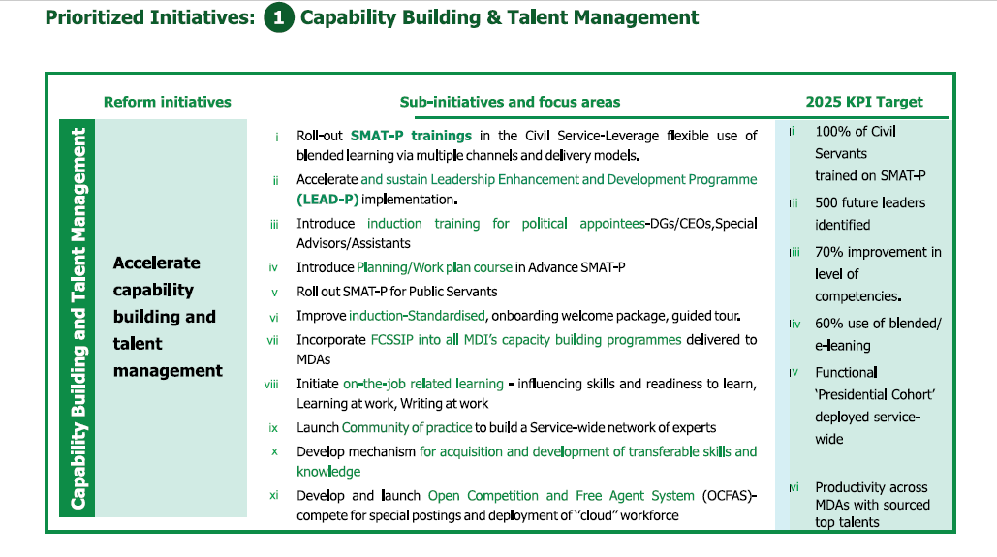
10
PILLAR 1 - CAPACITY BUILDING AND TALENT MANAGEMENT

Slide 13
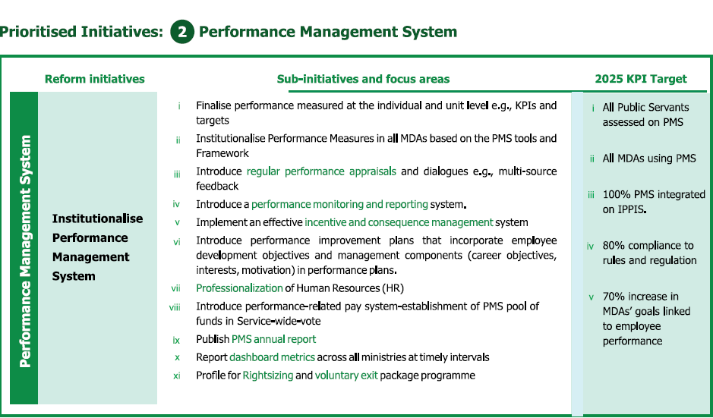
PILLAR 2 – INSTITUTIONALIZE PERFORMANCE MANAGEMENT (PM)

Slide 14
PILLAR 3- IPPIS-HR

Slide 15
PILLAR 4 – INNOVATION

Slide 16
PILLAR 5 – DIGITALIZATION – CONTENT SERVICES

Slide 17
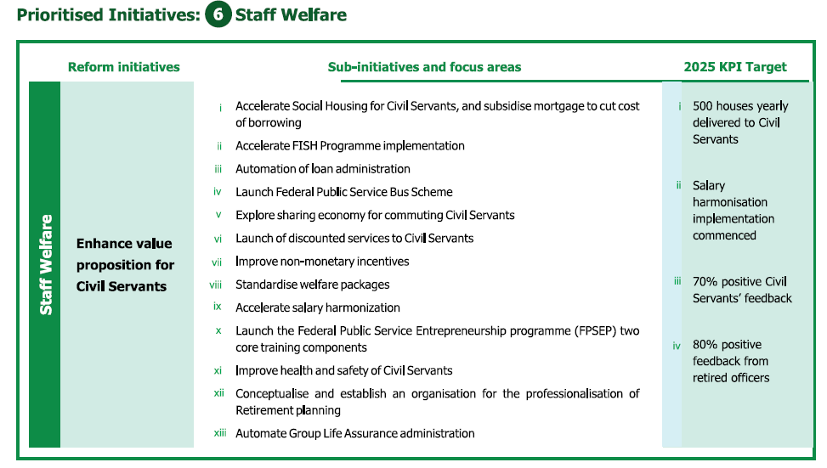
PILLAR 6: VALUE PROPOSITION FOR CIVIL SERVANTS

Slide 18
FCSIPP25 EXPECTED STRATEGIC OUTCOMES
Improved staff competencies and skills;
Improved productivity and HR administration;
Results-based performance and meritocratic environment;
Clear career path value proposition;
More innovative;
Value-driven and
Digitally transformed.

Slide 19
CORE VALUES (AMPLE)

Slide 20
CONCLUSION
The Nigerian government is demonstrating strong political will to solve all the identified problems in the country’s Federal Civil Service
The Civil Servants have an important role to play in consolidating the gains of all the ongoing reforms.
Civil Servants must consciously conform with the requirements of the new digital Civil Service.
The Civil Servants’ attitudinal and behavioral disposition must be favorable and supportive of the changes that the ongoing reforms are throwing up

Slide 21
THANK YOU

