Slide 1

OVERVIEW OF THE PUBLIC SERVICE PERFORMANCE MANAGEMENT SYSTEM, MPMS, EPMS.
PERFORMANCE MANAGEMENT DEPARTMENT
OHCSF
BY
ABIODUN AJAYI, Bsc, MPA, CMD cert.
,
@ 2025

Slide 2
LEARNING OBJECTIVES
At the end of this session, participants will be able to;
Understand the general overview of PMS and FCSSIP 2021-2025;
Identify concept of EPMS and MPMS;
Understand the goals and objectives of PMS;
View the defects of the outgone APER and benefits of the modern PMS;
State the roles of key role players in the implementation of PMS;
Understand the whole government approach to Performance PMS;
Identify the challenges and achievement of PMS so far; and
Conclusion and recommendation.

Slide 3

PREAMBLE
01
When the capacity of government to deliver service to Nigerians is called to question, then there is an urgent need to put in place mechanisms to safeguard the quality, competence, capacity, productivity and integrity of the public service for consistent and optimum service delivery

Slide 4
PREAMBLE
Excellence in governance is a direct outcome of effective management of the public trust
The Nigerian people bank their trust with government and expect government to act with conscience at every point in time
The functionality or impact of government in delivering service depends on the quality, competence, capacity, productivity and integrity of the public service
Public service comprises few privileged individuals who were appointed to occupy positions and create value for all Nigerians

Slide 5

PREAMBLE
Series of unprofessional conduct or behaviour including:
Incompetence
Truancy
Non-punctual
Poor attitude (chatiing away, youtubing)
Failure to execute duties in line with expected standard
Mental laziness/poor attitude to work
Insubordination and disrespect to seniors
corruption
Meritocracy
Transparency
Professionalism
Anonymity
Integrity
Discipline
Impartiality
Political neutrality
Patriotism
Accountability
Decreased productivity
Diminished quality of work
Poor service delivery

Slide 6
PILLAR 2
The New Performance Management System
02

Slide 7



FEDERAL CIVIL SERVICE STRATEGY AND IMPLEMENTATION PLAN 2021-2025 (FCSSIP25)
Vision:
To lead
a world-class service
for accelerated national development
Mission:
We provide a professional and efficient work force that is merit-based, accountable and responsive to the citizens and other stakeholders
FCSSIP 25 Strategic Results:
Improved staff competencies and skills, Improved productivity and HR administration, results-based performance and meritocratic environment, clear career path value proposition, a more innovative, value driven , and digitally transformed
service
Capability Building &
Talent
Performance Management
IPPIS -
Human Resource
Digitalization
- Content Services
Innovation
Staff Welfare
Enablers:
Culture change, change management, partnership, leverage technology, data & analytics, digital skills, conducive work environment consequence management, M&E , effective communication, political buy-in, inclusive engagement, funding & timely release of funds ,

Slide 8
OBJECTIVES OF FCSSIP25
FCSSIP25 was developed in alignment with the Medium Term National Development Plan 2021-2025
To have clarity and relevance on the vision, mission core values of the Civil Service
To ensure alignment with strategic direction with the need of the citizens and the National Development Plan
To establish a framework for tracking performance and taking corrective actions
Provides the roadmap for actualization of the vision, goals, objectives and proposed activities and programmes of the service in the next five years
To ensure adoption of communication and change management plan that would ensure sustainability of the required transformation
To enhance civil servants’ effectiveness and efficiency in service delivery to citizens
The ongoing reform is therefore being carried out to have a merit-driven public service that is fit for purpose, development-oriented and competitive in order to have optimal performance.

Slide 9
Definition of Performance & Performance Management
  Performance:
  Fulfilment of job duties and achievement of objectives.
Performance Management:
A systematic process to plan, monitor, evaluate, and improve individual and organizational performance.
  “PMS shall focus on measurable output (objectives and targets) and specified competencies…” — PSR §050202

Slide 10
WHAT IS PERFORMANCE MANAGEMENT SYSTEM?
Performance Management System
A Performance Management System is a mechanism for:
  Aligning organizations mission, goals, and objectives with available resources (Manpower, material, financial). This is done by streamlining employee performance and efforts to match the set goals efficiently
  tracking the performance of employees consistently and measurably
  setting targets, measuring results and assessing performance
PMS consists of the processes used to identify, encourage, measure, evaluate, improve, and reward employee performance at work.
PMS therefore provides the building blocks to translate an organization’s long-term aspirations into near-term goals and that safeguard the merit principles in public administration
Performance
Management
System

Slide 11
DIFFERENCES BETWEEN TRADITIONAL APPRAISAL & NEW PMS
Traditional Performance Appraisal | Performance Management
Held annually | Held quarterly, monthly, weekly or daily
Focus on individual objectives | Focus on organizational and individual objectives
Focus on levels of performance | Focus on performance and development of employees
Little or no conversations | Two-way conversations
Don’t review past performance | Review recent performance and coach to impact, development, & growth
Closed-door policy | Open-door policy
Little to no transparency | Transparent and collaborative
Based on subjective opinion | Based on rich and real-time staff’s data
Result in a rating and non-follow-up | Conclude with next steps and follow-up

Slide 12
Prioritized Initiatives: Performance Management
Reform initiative
Sub-initiatives and focus areas
2025 KPI Target
Institutionalize performance management
All public servants assessed on PMS.
100% PMS integrated on IPPIS
80% compliance to rules and regulations
70% increase in MDA’s goals linked to employee performance
Performance Management
Finalize performance measures at the individual and unit level e.g., KPIs and targets
Introduce a cadence of regular performance appraisals and dialogues e.g., multi-source feedback Introduce a performance monitoring and reporting system
Implement an effective incentive and consequence management system
Introduce development plans that incorporate employee development objectives and components (career objectives, interests, motivation) in performance plans
Professionalization of HR
Introduce performance-related pay system – establishment of PMS pool of funds in service-wide-vote
Publish a public annual report
Report dashboard metrics across all ministries at timely intervals
Profile for Rightsizing and voluntary exit package programme

Slide 13
PERFORMANCE MANAGEMENT SYSTEM (PMS)
MINISTERIAL/INSTITUTIONAL PMS (MPMS)
EMPLOYEE PMS (EPMS)

Slide 14
EMPLOYEE PMS (EPMS)
PLANNING
REVIEW
APPRAISAL

Slide 15
Performance Management Process
1. Planning:
    Setting SMART goals and KPIs.
2. Review (Monitoring):
    Regular progress checks and feedback.
3. Appraising:
    Self + supervisor done quarterly
4. Rewarding:
    Performance-based recognition, incentives.
5. Developing:
    Training and growth opportunities.
“Performance Review/Apprisal shall be responsibility of the immediate supervisor…” — PSR 050403

Slide 16
GOALS OF NEW PERFORMANCE MANAGEMENT SYSTEM
Performance Management seeks to accomplish the following:
01
02
03
04
Alignment –
To align individual goals with corporate goals
Assessment –
To serve as basis to objectively evaluate performance
Aid –
To provide feedback on areas for development and improvement of employees
Achievement - To motivate employees to improve performance and achieve set objectives

Slide 17
MERITS OF PERFORMANCE MANAGEMENT SYSTEM IN THE PUBLIC SERVICE
Implementation of Performance Management System in the Public Service will support in restoring Service Culture and set the Service on the path to Improved service delivery
01
03
Alignment –
To align Departmental and individual job objectives with MDA’s goals
Communication -
Performance Management builds required communication system between a supervisor and and supervisee in support of accomplishing the strategic objectives of the organization
02
04
Participation -
it ensures active participation of all employees in delivering the right actions to ensure the attainment of strategic mandate of the MDA
Assessment –
To serve as basis to objectively evaluate performance

Slide 18
MERITS OF THE PMS cont’d
05
06
Feedback –
To provide feedback on areas for development and improvement of employees
Culture –
establishes a delivery culture in an organization and a culture that emphasizes development and optimum utilization of human resources
07
08
Problem solving –
empowers employees to solve problems and delivery within areas of responsibility
Improvements –
enables organizations to effectively run on a day-to-day basis and to initiate and sustain improvement in processes
09
Achievement –
To motivate employees to improve performance and achieve set objectives

Slide 19
WHOLE OF GOVERNMENT APPROACH
In the context of the New Performance Management System (PMS), a Whole of Government Approach has been adopted, that involves the integration of performance management processes across all government agencies.
Instead of each agency operating independently, they align their individual performance management systems with overarching government priorities and objectives. The aim is to create a unified, coordinated effort that maximizes efficiency, avoids duplication of efforts, and ensures that the entire government machinery is working towards common goals.
Performance
Management
System

Slide 20



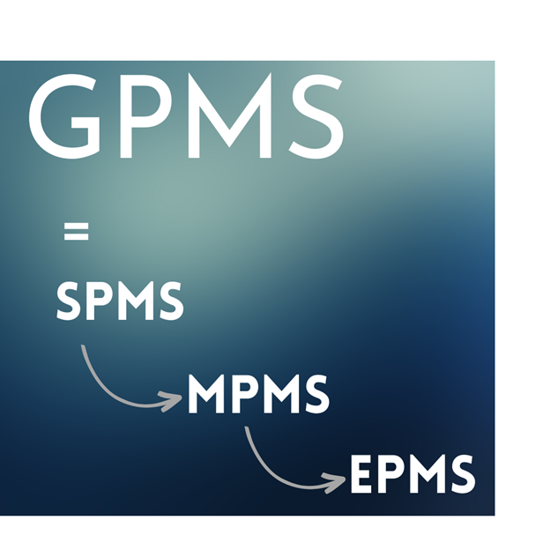
THE WHOLE OF GOVERNMENT APPROACH TO PMS
National Development Goals as prioritized by Government
MDA’s Goals & Objectives
Departments Job Objectives
Division, Branches/Units & Sections Objectives
Departmental
plan
Individual Employee Job Objectives

Slide 21
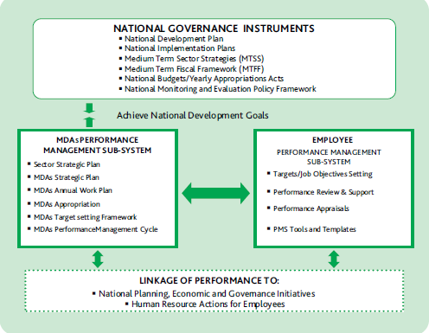
ALIGNMENT OF KEY GOVERNMENT INSTRUMENTS

Slide 22








Boost Agriculture to Achieve Food Security
Reform the Economy to deliver Sustained Inclusive Growth
Strengthen National Security for Peace and Prosperity
Unlock Energy and Natural Resources for Sustainable Development
Enhance Infrastructure and Transportation as Enablers of Growth
Priority Areas
Focus on Education, Health and Social Investment as Essential Pillars of Development
Accelerate Industrialization through Digital Economy, Manufacturing and Innovative Technology
Improve Governance for Effective Service Delivery

Slide 23
WEIGHTINGS AND CRITERIA VALUES
Performance Criteria Categories and total weights have been predetermined and agreed
Cannot be altered within a given performance management cycle unless (in exceptional cases), agreed mutually between the MDA and the OHCSF
For standardization, the requirements and contents of the performance criteria categories for each MDA shall be published annually on the Performance Management Portal of the OHCSF
  Each performance criterion has a fixed weight.
  The weights should be distributed, in negotiated proportions, to the various performance indicators under each criterion.
  The weight shows the relative importance of each indicator as agreed by the negotiating parties.

Slide 24
WEIGHTINGS AND CRITERIA VALUES
Criteria values are set for each KPI
Outstanding
Excellent
Very Good
Good
Fair
Poor

Slide 25


Linkage of institutional performance management with employee performance management
01
02
03
PRESIDENTIAL DELIVERABLES (38%)
OPERATIONAL KRAs (25%)
SERVICE-WIDE KRAs (37%)
MINISTERIAL PERFORMANCE MANAGEMENT SYSTEM

Slide 26





CASCADING OF DELIVERABLES!
Performance Contracts for each Sector and each MDA shall be finalized at the following Performance Planning Retreats in order to achieve cascading of deliverables
Government prioritized deliverables (38%) are cascaded to the Permanent Secretary (s) and Chief Executives of Agencies and Parastatals in each sector. Contract must be signed between the PS, CEOs and the Honourable Minister (s) at the end of the retreat.
SECTORAL RETREAT
This is the retreat of the PS with all Directors /Heads of Units where deliverables signed by the PS is cascaded to Departments. The aggregation of Presidential Deliverables, Operational and Service Wide KRAs is what is cascaded to all Department in this retreat
MDA RETREAT
Service-wide Retreat
This shall have in attendance the Head of the Civil Service of the Federation and Permanent Secretaries service-wide

Slide 27
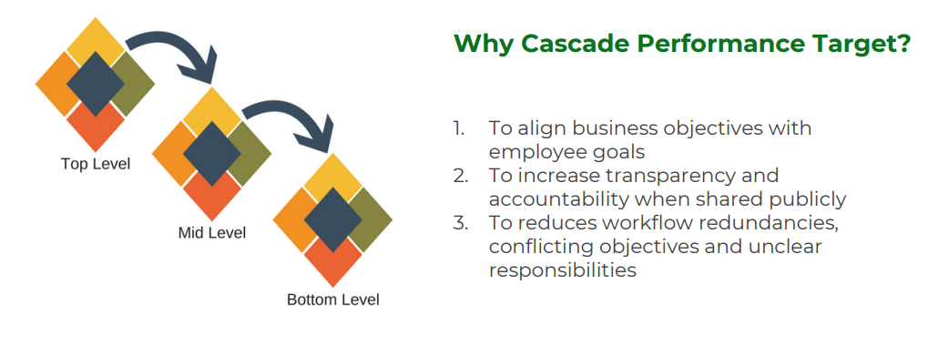
CASCADING OF JOB OBJECTIVES/PERFORMANCE TARGETS

Slide 28
HOD
SENIOR LECTURER1
SENIOR LECTURER 2
SENIOR LECTURER 3
LECTURER 3
LECTURER 1
LECTURER 1
LECTURER 2
ASST. LECTURER1
ASST. LECTURER2
LECTURER 2
ASST. LECTURER

Slide 29
PMS JOB OBJECTIVE SETTING TOOLS
KEY
PERFORMANCE
INDICATORS (KPIs)
TARGETS
SMART OBJECTIVES
TIMELINES
KEY
RESULT
AREA (KRAs)
JOB OBJECTIVE
COMPETENCIES

Slide 30
Key Result Areas (KRAs)
Key Result Areas…
Most important areas of responsibility that an individual or team needs to focus on to achieve their objectives and goals.
Broad level of responsibilities for which a Ministry or Team is accountable (mandate areas).
Area(s) of business operations where it is profoundly important to achieve results.
30

Slide 31
Key Result Areas… Cont’d
It usually starts with a NOUN. Could be a word or phrase
Example :
  Teachers’ Certificates accreditation
  Guidelines approval
  Information analysis and collation
  Advisory role
  Monitoring and Evaluation
31

Slide 32
OBJECTIVE
OBJECTIVE:
Used to define the specific outcomes that individuals or teams are responsible for achieving within a given time period
Objectives may be set at the level of the MDA or at Divisional, Department, Team or Individual levels.
When writing objectives, use action-oriented Verbs which describe what needs to be done to achieve the objectives. e.g Prepare, Review, Coordinate etc
SMART OBJECTIVES
Specific – outline in a clear statement precisely what is required.
Measurable – include a measure to enable organisations to monitor progress and to know when the objective has been achieved.
Achievable (or agreed) - objectives should be agreed by Supervisors and Supervisees to ensure commitment to them and also take responsibility for them.
Realistic (or relevant) - focus on outcomes, rather than the means of achieving them.
Time-bound (or time-bound) – agree the date by which the outcome must be achieved.

Slide 33
SMART OBJECTIVES:
SMART OBJECTIVEby S
Achieve 100% accreditation of teachers certificates and other academic awards before the commencement of new academic session.
Approve 80% guidelines setting out criteria for accreditation of all colleges of Education in Nigeria before end 2025.

Slide 34
KEY PERFORMANCE INDICATORS (KPIs)
A KPI is a measurable value that demonstrates how effectively you express what you want to achieve and by when.
They are the quantifiable, outcome-based statements you'll use to measure if you're on track to meet stated objectives.
KPIs need to be defined according to critical or core objectives
KPIs start with $ = Value
# = Number
% = Percentage
= yes or no
# of days to fill a vacancy
% of eligible employees who receive promotions
% of employees who report satisfaction with the disciplinary process

Slide 35
Key Performance Indicators (KPIs)
Metrics: Anything you can measure
Key Performance Indicators - quantifiable, outcome-based statements used to measure achievement of objectives.
The operative word in KPI is “Key” because every KPI should be related to a specific outcome with a performance measure.
COUNT!
What you measure
% of information collated and published.
Number of certificates accredited.
Number of guidelines approved.
35

Slide 36

TARGET
Target: the desired result you wish to achieve in relation to a KPI
36

Slide 37
PERFORMANCE PLANNING PROCESS FLOW
1
Understand the Mandate:
Vision, Mission, Mandate and Strategic Objectives
2
Establish Key Activities
Establish Key Result Areas and develop Operational Plans
3
Define KPIs
Develop KPIs for MDAs and Departments
6
Reassess KPIs and Weights
Ensure KPIs are SMART
5
Assign Weights
Prioritize KPIs for assign weights
4
Define KPIs
Develop KPIs for MDAs and Divisions/Branches & Sections
7
Performance Contract
Sing-off Performance Contracts
8
Circulate
Circulate Performance Contracts to Dept., Div. Branches/Units

Slide 38
PILLAR 2
ACHIEVEMENTS
Over 2000 officers service-wide trained in PMS
PMS incorporated in FCSSIP25
Review and Validation of PMS Policy Guidelines
Completed Job Objectives Setting for CORE MDAs
Service-wide development of SOPs
PMS appraisal scores to be used for 2025 promotion exercise
Sensitization of Top Management and staff at MDAs
Ongoing deployment of appropriate Automation Infrastructure
PMS incorporated in PSR
Training by CIPM & PMS dept. in HOS for 5 pilot MDAs

Slide 39
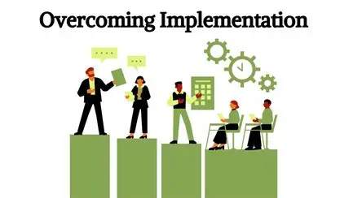
Challenges in PMS Implementation
Resistance to change and institutional Passivity.
Limited ICT infrastructure and digital skills.
Absence of Consequence Management
Funding and Timely Release of Fund

Slide 40
Summary
and
Conclusion

Slide 41

SUMMARY
Performance Management constitutes the second pillar of the FCSSIP 25
PMS implementation in the Federal Public Service took effect from 1st January, 2023
The New PMS adopted the Whole of Government Approach in its implementation
The MPMS will be developed using the Government Priorities, Operational Deliverables and Service-Wide Deliverables
This will be cascaded to all levels of accountability to serve as Linkage of institutional performance management with employee performance management
When performance management is sustainable and leadership is actively involved, the public sector is better equipped to deliver high-quality, efficient, and responsive services that meet the needs of the people it serves.

Slide 42
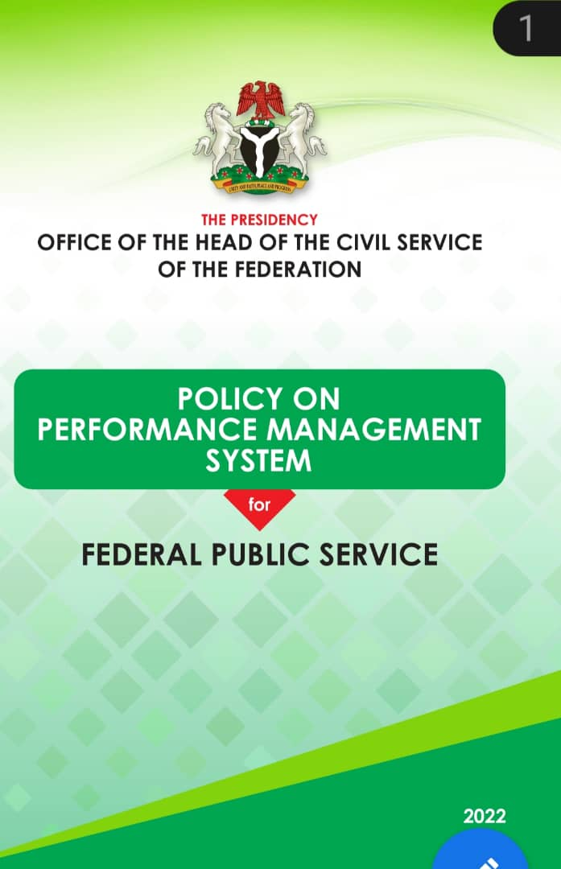
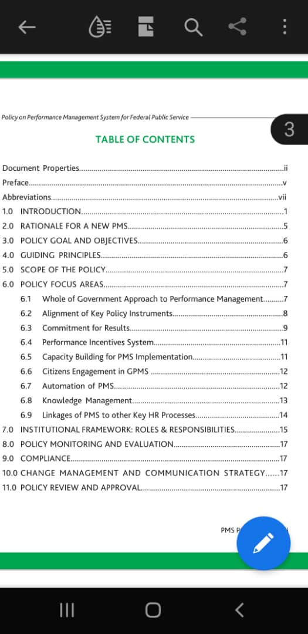
PMS POLICY

Slide 43
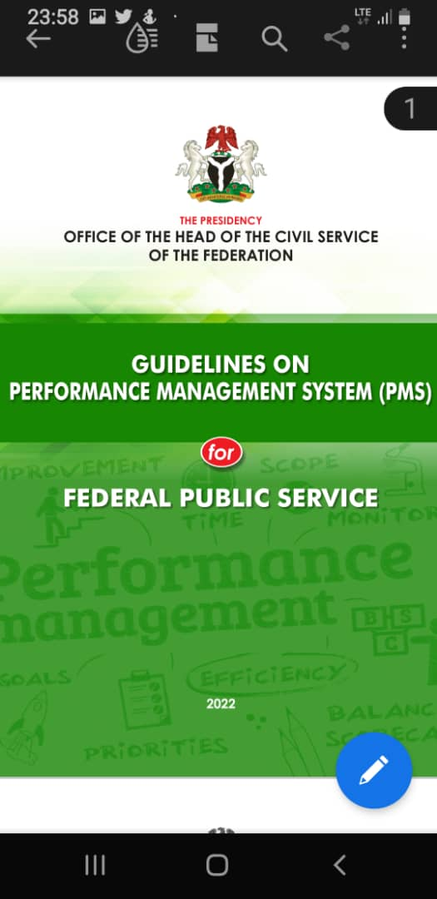
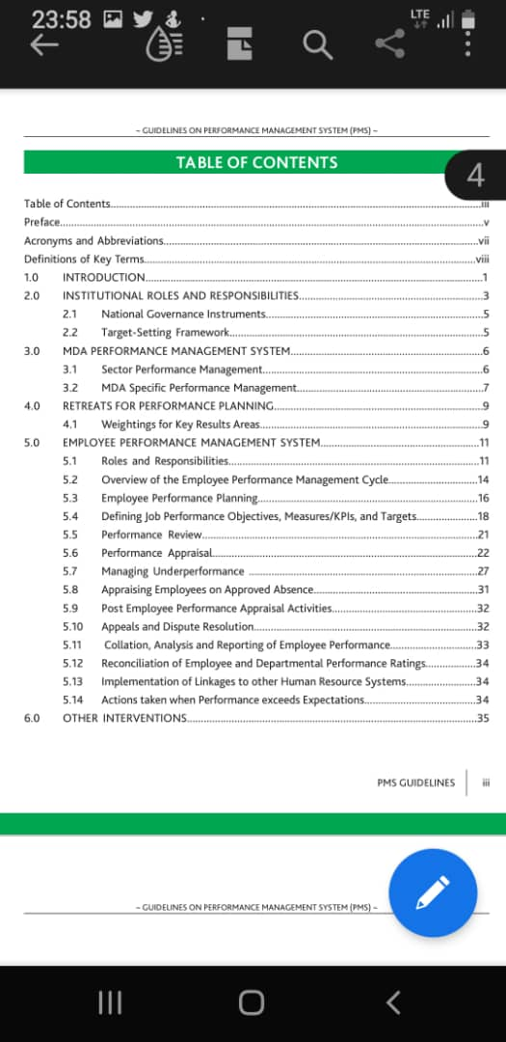
PMS GUILDLINES

Slide 44

ITS’S ALL ABOUT NIGERIANS

Slide 45

THANK YOU
PERFORMANCE MANAGEMENT DEPARTMENT,
OFFICE OF THE HEAD OF CIVIL SERVICE OF THE FEDERATION, BLOCK B, 7TH FLOOR
FEDERAL SECRETARIAT COMPLEX, PHASE II,
SHEHU SHAGARI WAY,
ABUJA, NIGERIA.

Slide 46

Any Question?

