Slide 1



Slide 2
PRESENTATION BY
DR. CLARIS UJAM
AT THE
SENSITIZATION MEETING OF STAKEHOLDERS IN COLLEGES OF EDUCATION ON THE IMPLEMENTATION OF MINISTERIAL DELIVERABLES AND THE NIGERIA EDUCATION SECTOR RENEWAL INITIATIVES (NESRI)

Slide 3
CONTENTS
Introduction
Our Vision
Our Mission
Mr. President’s 8-Point Agenda
Ministerial Deliverables: Key Performance Indicators / Templates
NESRI
Collaborations

Slide 4
INTRODUCTION
The Federal Ministry of Education is responsible for formulating national policies and guidelines for standardizing education at all levels in Nigeria. This is enshrined in various statutory instruments, principally the Constitution of the Federal Republic of Nigeria, 1999 (as amended).of Nigeria, 1999 (as amended).

Slide 5
OUR VISION
To Become An Economy Model, Delivering Sound Education For The Public Good

Slide 6
OUR MISSION
  To Use Education As A Tool For Fostering Development Of All Nigerian Citizens To Their Full Potential In The Promotion Of A Strong, Democratic, Egalitarian, Prosperous, Indivisible And Indissoluble Sovereign Nation Under God

Slide 7
Ministerial Performance Bond fo Presidential Priorities and Deliverables (2023 – 2027)
Presidential Priorities and Deliverables (2023 – 2027)
FEDERAL EXECUTIVE
COUNCIL (FEC) RETREAT
D ON
Federal Executive Council (FEC) Retreat
Held On
Wednesday 1st – Friday 3rd November 2023
At
State House Banquet Hall, Abuja.
WEDNESDAY 1ST – FRIDAY 3RD NOVEMBER 2023
AT
STATE HOUSE BANQUET HALL, ABUJA.

Slide 8
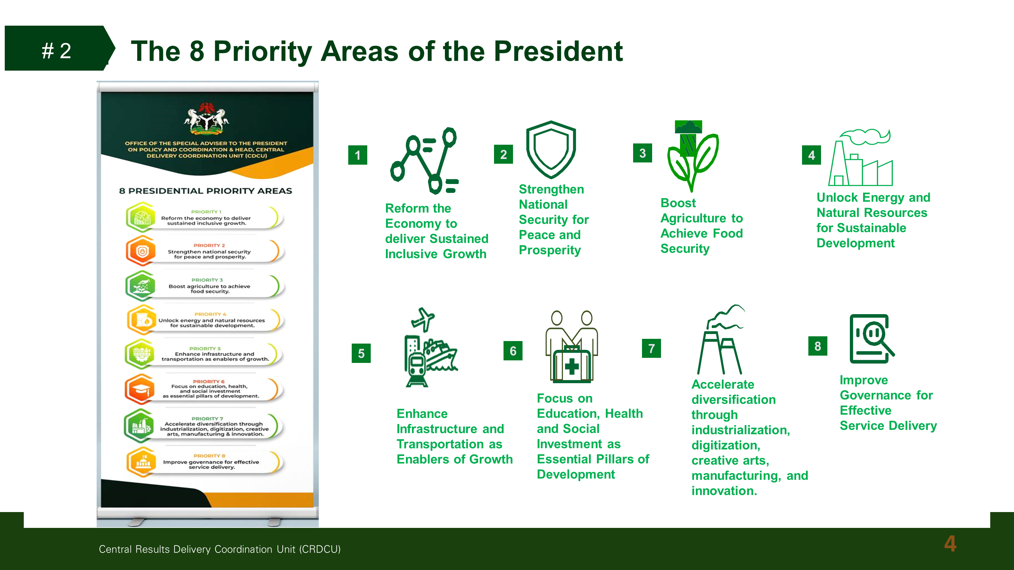

MR. PRESIDENTS 8-POINT AGENDA

Slide 9
23 MINISTERIAL DELIVERABLES ASSIGNED TO FME

Slide 10
MINISTERIAL DELIVERABLES 2

Slide 11
MINISTERIAL DELIVERABLES 3

Slide 12
MINISTERIAL DELIVERABLES 4

Slide 13
MINISTERIAL DELIVERABLES 5

Slide 14
MINISTERIAL DELIVERABLES 5

Slide 15
MINISTERIAL DELIVERABLES 6

Slide 16
MINISTERIAL DELIVERABLES 7

Slide 17
MINISTERIAL DELIVERABLES 8

Slide 18
MINISTERIAL DELIVERABLES 9
Establish a mechanism for inter-governmental relations (PPP, increased school enrolment, transition and completion for learners especially those with disabilities) | Public-Private Sector Roundtable on Education established
 | Operational guidelines for Roundtable developed (including areas of collaboration)
 | Percentage (%) implementation of action plan for identified areas of collaboration.
 | Total value of funds disbursed for feeding in Unity Schools
 | Months of release of funds to Unity Schools
 | Percentage (%) increase in enrolment, retention, transition and completion rates for primary and secondary education- Disaggregated by gender, region and disability.
 | Percentage (%) increase in literacy and numeracy rates for primary schools. (ANNUALLY)

Slide 19
MINISTERIAL DELIVERABLES 9
Establish a mechanism for inter-governmental relations (PPP, increased school enrolment, transition and completion for learners especially those with disabilities)
 | % increase in enrollment rate for secondary education- Disaggregated by gender, region and disability (ANNUALLY)
 | % increase in retention rate for primary- Disaggregated by gender, region and disability (ANNUALLY)
 | % increase in retention rate for secondary education- Disaggregated by gender, region and disability (ANNUALLY)
 | % increase in transition rate for primary education- Disaggregated by gender, region and disability (ANNUALLY)
 | % increase in transition rate for secondary education- Disaggregated by gender, region and disability (ANNUALLY)
 | % increase in completion rate for primary education- Disaggregated by gender, region and disability (ANNUALLY)
 | % increase in completion rate for secondary education- Disaggregated by gender, region and disability (ANNUALLY)

Slide 20
MINISTERIAL DELIVERABLES 10

Slide 21
MINISTERIAL DELIVERABLES 11

Slide 22
MINISTERIAL DELIVERABLES 12

Slide 23
MINISTERIAL DELIVERABLES 13

Slide 24
MINISTERIAL DELIVERABLES 14

Slide 25
MINISTERIAL DELIVERABLES 15

Slide 26
MINISTERIAL DELIVERABLES 16

Slide 27
MINISTERIAL DELIVERABLES 17

Slide 28
MINISTERIAL DELIVERABLES 18

Slide 29
MINISTERIAL DELIVERABLES 18

Slide 30
MINISTERIAL DELIVERABLES 19

Slide 31
MINISTERIAL DELIVERABLES 20

Slide 32
MINISTERIAL DELIVERABLES 21

Slide 33
MINISTERIAL DELIVERABLES 22

Slide 34
MINISTERIAL DELIVERABLES 23

Slide 35
HIGH IMPACT MINISTERIAL DELIVERABLE
DELIVERABLE | KPI | 2024 Actual (Baseline) | 2025 Annual Target | Q1 TARGET | Q1 ACTUAL | Q2 TARGET | Q2 ACTUAL
1: Design and implement incentive schemes for excellent students in STEMM courses | 1.1: Number of STEMM incentive schemes implemented
 | 1.2: Number of students benefitting from STEMM related scholarship schemes
 | 1.3: Number of students benefitting from STEMM related internship schemes
 | 1.4: Number of active research being undertaken in STEMM leading to new products.

Slide 36
HIGH IMPACT MINISTERIAL DELIVERABLE
DELIVERABLE22 | KPI | 2024 Actual (Baseline) | 2025 Annual Target | Q1 TARGET | Q1 ACTUAL | Q2 TARGET | Q2 ACTUAL
2. Initiate and implement quarterly citizens and stakeholder engagement sessions to communicate government activities and serve as feedback mechanism. | 2.1 Number of engagements with citizens (physical or virtual) held per year
 | 2.2 Number of new initiatives/adjustments made in response to feedback from citizens

Slide 37
HIGH IMPACT MINISTERIAL DELIVERABLE
DELIVERABLE3 | KPI | 2024 Actual (Baseline) | 2025 Annual Target | Q1 TARGET | Q1 ACTUAL | Q2 TARGET | Q2 ACTUAL
3. Implement Digitalisation Policy to increase access to learning in collaboration with NITDA | 3.1 Number of learners accessing government e-learning platforms (eLearn, Inspire, NLP, etc)
 | 3.2 Number of public schools with access to digital learning aids
 | 3.3 Number of teachers trained in digital literacy and online safety
 | 3.4 Number of teachers utilising the government CPD platforms (eLearn, Ignite, Inspire, NLP, UBEC Skill-Up etc)
 | 3.5 Number of EdTech strategies developed and deployed in schools

Slide 38
HIGH IMPACT MINISTERIAL DELIVERABLE
DELIVERABLE | KPI | 2024 Actual (Baseline) | 2025 Annual Target | Q1 TARGET | Q1 ACTUAL | Q2 TARGET | Q2 ACTUAL
4. Initiate and implement policies to increase access to quality education for the girl-child at all levels (including National Policy on Safety, Security and Violence Free Schools | 4.1 Number of advocacies to sensitise communities on Girl -Child Education and safe schools
 | 4.2 Number of states implementing the safe schools policy
 | 4.3 Number of girls benefitting from scholarships and related schemes

Slide 39
HIGH IMPACT MINISTERIAL DELIVERABLE
DELIVERABLE | KPI | 2024 Actual (Baseline) | 2025 Annual Target | Q1 TARGET | Q1 ACTUAL | Q2 TARGET | Q2 ACTUAL
5. Strengthen the Education Management Information System (EMIS) for effective decision-making. | 5.1 Number of schools captured in the EMIS
 | 5.2 Number of teachers captured in EMIS
 | 5.3 Number of states uploading their data to NEMIS portal at stipulated times
 | 5.4 Number of states with access to the NEMIS portal.

Slide 40
HIGH IMPACT MINISTERIAL DELIVERABLE
DELIVERABLE | KPI | 2024 Actual (Baseline) | 2025 Annual Target | Q1 TARGET | Q1 ACTUAL | Q2 TARGET | Q2 ACTUAL
6. Strengthen and enforce the certification and licensing framework for teachers in Basic and Senior Secondary Schools across Nigeria, in collaboration with States and relevant stakeholders, to enhance education quality assurance and professional standards. | 6.1 Number of teachers certified and licensed in Basic and Senior secondary schools
 | 6.2 Number of certified and licensed teachers trained in Basic and Senior secondary schools
 | 6.3 Number of school assessments /external evaluations conducted in basic schools
 | 6.4 Number of school assessments /external evaluations conducted in senior secondary schools

Slide 41
HIGH IMPACT MINISTERIAL DELIVERABLE
DELIVERABLE | KPI | 2024 Actual (Baseline) | 2025 Annual Target | Q1 TARGET | Q1 ACTUAL | Q2 TARGET | Q2 ACTUAL
7. Initiate and implement strategies to mitigate OOSC challenge (including infusion of foundational literacy and numeracy skills into the curriculum for learners in non-formal setting. | 7.1 Number of monitoring sessions conducted in non-formal learning centres
 | 7.2 Number of strategies implemented to reduce the number of OOSC
 | 7.3 Number of non-formal learners trained in TVET
 | 7.4 Number of OOSC identified and enrolled in schools

Slide 42
HIGH IMPACT MINISTERIAL DELIVERABLE
DELIVERABLE | KPI | 2024 Actual (Baseline) | 2025 Annual Target | Q1 TARGET | Q1 ACTUAL | Q2 TARGET | Q2 ACTUAL
8. Initiate and implement strategies to ensure that students have access to finance their education | 8.1 Amount of funds disbursed by NELFUND to students (Upkeep Allowance)
 | 8.2 Number of students benefiting from students' loans - disaggregated by gender, state and by course (either a social science or STEM)
 | 8.3 Number of institutions accessing the NELFUND
 | 8.4 Amount of funds disbursed by NELFUND to institutions (institution fees)
 | 8.5 Total amount of funds disbursed by NELFUND

Slide 43
HIGH IMPACT MINISTERIAL DELIVERABLE
DELIVERABLE | KPI | 2024 Actual (Baseline) | 2025 Annual Target | Q1 TARGET | Q1 ACTUAL | Q2 TARGET | Q2 ACTUAL
9.Establish a mechanism for inter-governmental relations to increase enrolment, transition, and completion for learners (especially those with disabilities) | 9.1 Number of Unity Schools upgraded to technical college
 | 9.2 Number of facilities equipped for persons with disabilities in primary schools
 | 9.3 Number of facilities equipped for persons with disabilities in secondary schools
 | 9.4 Percentage completion of the UBEC Act review/amendment
 | 9.5 Percentage implementation of the Strategic Roadmap for Inclusive Access to Quality Higher Education in Nigeria (2024 - 2028) National Standards
 | 9.6 Number of strategies developed and implemented with State MDAs to increase enrolment, transition and completion for learners
 | 9.7 Percentage increase in students with special needs attending Tertiary Institutions
 | 9.8 Percentage increase in students with disability enrolled Tertiary Institutions

Slide 44
HIGH IMPACT MINISTERIAL DELIVERABLE
DELIVERABLE | KPI | 2024 Actual (Baseline) | 2025 Annual Target | Q1 TARGET | Q1 ACTUAL | Q2 TARGET | Q2 ACTUAL
10. Review the status of technical and vocational education in Nigeria, revise TVET programs and prioritize the acquisition of entrepreneurship education at all levels | 10.1 Number of schools implementing the newly revised programs on TVET
 | 10.2 Number of revised programs implemented in TVET
 | 10.3 % increase in students taking technical and vocational courses at senior secondary school levels
 | 10.4 Number of teachers trained in entrepreneurship
 | 10.5 Number of certifications issued for vocational training (including tech-specific discipline)
 | 10.6 Number of TVET or Vocational Training Centers rehabilitated/upgraded
 | 10.7 Number of students enrolled in new TVET training facility

Slide 45
NIGERIA EDUCATION SECTOR RENEWAL INITIATIVE (NESRI)
SIX PRIORITY / FOCUS AREAS
TVET
STEMM
OUT-OF SCHOOL CHILDREN
GIRL-CHILD EDUCATION
DATA AND DIGITIZATION
EDUCATION QUALITY ASSURANCE

Slide 46
HIGH IMPACT MINISTERIAL DELIVERABLE
PROJECT TEMPLATE

Slide 47

COLLABORATION

Slide 48
THANK YOU FOR LISTENING

