Slide 1



Nigeria Education Data Initiative
Abubakar K. Isah
Vice Chairman
Federal Ministry of Education
Abuja - Nigeria
24 June 2025

Slide 2

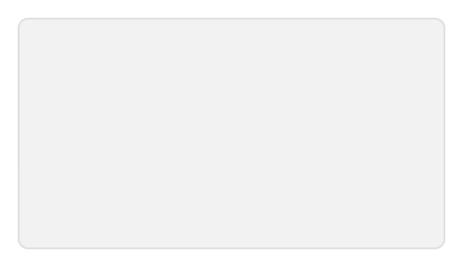





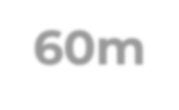









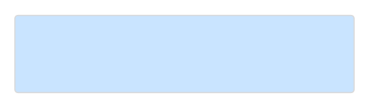











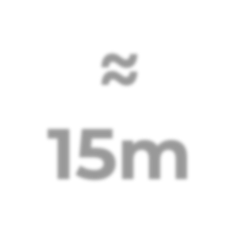












The challenges in the Nigerian Education Sector Data Collection presents a marked opportunity to increase access, improve quality and enhance systems
60m
Untapped Demographic
Children Aged 5-14
20m
Adolescent Girls Aged 12-19
60m
Youth Aged 15-29
Learning Poor Children Who Cannot Read Age-Appropriate
Text
45m
5m
6m
25%
National
41%
NE & NW
50%
Never Enrolled
25%
Drop out s
25%
Almajiri
Out of School Adolescent Girls
Out of School Children
30%
National
44%
NE+NW
Individuals Who
Become of Working
Age Each Year
≈ 15m
25%
103 per 1000*
Adolescent Fertility Rate
Youth Who Are NEET (Not in Education, Employment or Training)
2
World Bank Group * 103 per 1000 adolescent girls aged 15-19 years – National Average

Slide 3








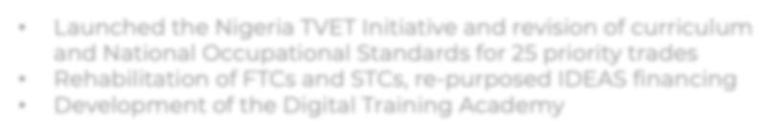





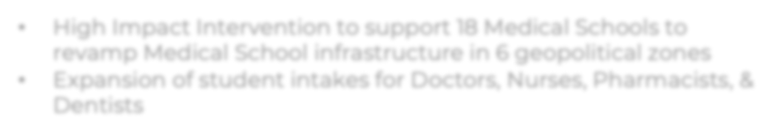






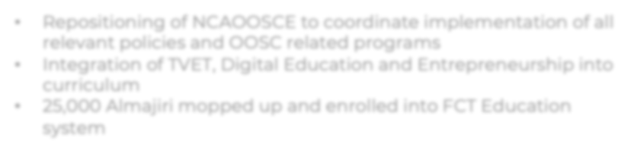

Performance across Priority Focus Areas
Focus Area
Fact
• •
•
Basic School
171,027
Total Number of Basic Schools in Nigeria
Focus Area
Fact
Senior Secondary Schools
• •
30,335
Total Number of Senior Secondary Schools in Nigeria
Focus Area
Fact
• • •
Enrolment
54,360,000
Total Number of Students in our School System
FCT – Federal Technical colleges | STC - State Technical Colleges | OOSC - Out of School Children |

Slide 4

Implementation Strategies
Data Mapping & Collection
Infrastructure & Technology
Presentations are communication tools that can be used as lectures.
Commenced an assessment and comprehensive mapping of existing data sources Identified a list of indicators for a data dictionary
Sustainability & Services
Governance & Regulations
Presentations are communication tools that can be used as lectures.
Developed a roadmap for sustainability implementations
Outreach for NIMC
Presentations are communication tools that can be used as lectures.

Slide 5

DATA SOURCES: BASIC EDUCATION (ECCDE – SS)
UBEC
UNICEF
Has digitally collected data of all schools (incl. private) from 2022 except SS. Data includes:
Supports 11 states (*Bauchi,*Borno, Edo, *Jigawa, *Kano, *Katsina, *Kebbi, Lagos, *Sokoto & Yobe, *Zamfara) with a Teacher-MIS platform and 8 States* with an EMIS. The LMIS is being deployed and trainings have begun at the State & LGA level. The EMIS is capable of capturing school level data and is based on UNESCO’s Intl. Classification Standards
School Location (Address & Geolocation) School Infrastructure Total no. of students Staff data (Teacher personal data)
Don’t have Individual student data
The EMIS doesn’t collect Student information
Private schools
NSSEC
NEMIS
Have various associations that collect their data i.e., National Association of Proprietors of Private Schools (NAPPS)
Only have data of Schools provided
Has complete data up till 2023 and collects information on schools including location, no. of students and teacher info.
by the States
All private school data is also collected by UBEC
Doesn’t collect teacher’s personal information

Slide 6

DATA SOURCES: TERTIARY
JAMB
NBTE
JAMB has the following categories of student’s
NBTE has the following categories of student’s data:
(individual and aggregated) data:
List of students enrolled at all PTs, MTs, IEIs, other ND and HND Awarding Institutions Graduate Output for all PTs, MTs, IEIs, other ND and HND Awarding Institutions
Exam applicants Exam registrations Successful admissions List of Matriculations –100L (ND1 or NCE1) students who were cleared, registered and are schooling at all Universities (263), PTs (211), MTs (283), Schools of Health (22), COE’s (231) and Innovation Enterprises Institutions (IEIs)
Doesn’t have Individual student data
Has incomplete enrolment and graduation data from
Universities and not all institutions are on their HND
Portal
NUC
NCCE
NUC has the following categories of student’s data:
NCCE has the following categories of student’s data up to 2022:
List of students enrolled at all Universities Graduate Output for all Universities
List of students enrolled at all Colleges of Education (COE)
Graduate Output for all COE’s
Doesn’t have individual data – has written to institutions in
request. Data is currently being collated

Slide 7

DATA INDICATORS (11)
STUDENT ENROLMENT & DEMOGRAPHICS
INFRASTRUCTURE & FACILITIES
FACULTY & STAFF METRICS
Student-to-faculty ration No.of academic vs non-academic staff Qualifications, and Specialisations Research output per faculty member Lecture workload and course allocation
Total student no. Per school and institution (ECDE, BE, SS, UG, PG, DP) Enrolment stats by gender, age, programme No. of Students that have travelled abroad vs local students No. of students with disabilities Admission rate (applications vs admissions)
No. & type of facilities (classrooms, lecture halls, auditoriums, labs etc.) with capacity/utilisation rates Library resources no. & type ICT facilities Accommodation availability and capacity
RESEARCH & INNOVATION
PARENTAL AND COMMUNITY ENGAGEMENT
TECHNOLIGICAL ADOPTION &
DIGITAL LEARNING
GOVERNANCE & INSTITUTIONAL
EFFECTIVENESS
EMPLOYABILITY & ALUMNI ENGAGEMENT
ACADEMIC PERFORMANCE & GRADUATION RATES
Graduate employment rates within 6- 12 months Expected Salary range for courses Alumni contributions and donations Endowment funds specifics Entrepreneurial ventures
Retention (year-to-year progression) Drop-out rates with reasons Graduation rates per programme and faculty Average CGPA per arm, year group, school, faculty, and programme
FINANCIAL PERFORMANCE &
FUNDING
STUDENT WELFARE & EXPERIENCE

Slide 8

1. 2.
WHAT HAS BEEN DONE?
DATA GOVERNANCE
Objective
Establish a robust governance architecture and regulatory environment for education data in the country, ensuring data privacy, security, and ethical use.
We have Conducted an assessment of existing data protection policies being used at agencies and organisations.
Reviewed Nigerian Data Protection Regulations 2019 and ISO 27001 regulations for potential certification

Slide 9
SUSTAINABILITY & SERVICES
Objective
TRAINING
Design and deliver training programs for relevant stakeholders, staff, educators on data collection, platform utilisation and operation.
Develop a long-term sustainability framework for NEDI with sustainable funding mechanisms by building local capacity and value added services.
FUNDING
Secure government budgetary allocation. Engage in PPPs with technology firms and DPs. Introduce a tiered model that allows analytics and reports are available on a cost-recovery basis
MAINTENANCE
Develop a strategy to ensure routine updates and maintenance of the data platform to prevent obsolescence.
POLICY GUIDANCE
Implement a data governance policy to standardise data collection storage and access to educational data across all agencies
MONITORING & EVALUATION
Define KPIs to track the impact of NEDI on education policy and learning outcomes. Publish open-access reports on education trends to maintain transperancy and public engagement
STRATEGIIEESS
CAPACITY BUILDING & STAKEHOLDER ENGAGEMENT
Create a capacity-building strategy for data management and use. Engage State and Local education authorities to integrate NEDI into their operational frameworks.

Slide 10
2020 UTME STATISTICS OF QUOTA/APPLICATION/ADMISSION BY SCIENCES AND ARTS (NCE)
A
B
C
SPECIALITY | QUOTA | INITIAL APPLICATION | ADMS | % of B to A | % of C to A | % of C to B | % of Quota Unused
ARTS | 151,358 | 25,134 | 31,046 | 17 | 20.51 | 123.52 | 79.49
SCIENCES | 82,199 | 11,085 | 16,866 | 13 | 20.52 | 152.15 | 79.48

Slide 11
2021 UTME STATISTICS OF QUOTA/APPLICATION/ADMISSION BY SCIENCES AND ARTS (NCE)
A
B
C
SPECIALITY | QUOTA | INITIAL APPLICATION | ADMS | % of B to A | % of C to A | % of C to B | % of Quota Unused
ARTS | 42,434 | 10,654 | 18,070 | 6.58 | 11.17 | 169.61 | 88.83
SCIENCES | 110,067 | 5,093 | 9,893 | 5.91 | 11.49 | 194.25 | 88.51

Slide 12
Nigerian Education Databank

Slide 13
Thank You

