Slide 1
Exploring Dual Mandate Models that Align with National
Education Policy Objectives and Institutional Realities
Delivered by:
Prof. Josiah O. Ajiboye
Department of Arts & Social Sciences Education, University of Ibadan
At the
National Summit of the Committee of Provosts of Colleges of Education in Nigeria on NCE &Degree Programmes
20th August, 2025
B.O. Ukeje Auditorium , NCCE, Abuja

Slide 2

Table of Contents
01
Preamble
02
Introduction
03
The Dual Mandate: Policy Rationale and Vision
04
Institutional Realities: Pre-Dual Mandate Landscape
05
Dual Mandate Implementation Framework
06
Alignment with National Policy Objectives
07
Proposed Implementation Models
Conclusion /Recommendation
Notes:
https://pixabay.com/photos/conference-room-table-office-768441/

Slide 3
PREAMBLE
This paper interrogates the recent policy shift allowing Federal Colleges of Education (FCEs) to operate under a dual mandate—awarding both the Nigeria Certificate in Education (NCE) and Bachelor’s degrees in Education concurrently.
Rooted in the Federal Colleges of Education Act 2023 and the FME Roadmap (2024–2027), this transition aims to resolve structural challenges in teacher education, enhance professionalism, and expand access to quality higher education.
The paper analyses the alignment between the dual mandate and national education policy objectives, identifies key implementation challenges, and proposes context-sensitive models that accommodate institutional differences across the colleges

Slide 4
Introduction
Teacher education in Nigeria is on the verge of a major transformation with the enactment of the Federal Colleges of Education (Establishment) Act, 2023. This legislative reform grants Colleges of Education the authority to offer both NCE and Bachelor’s degrees in Education simultaneously—known as the Dual Mandate.
The Federal Ministry of Education (FME) has endorsed the dual mandate as a transformative strategy for reforming teacher education. It is explicitly captured under Sections 2(2)(d) and 2(2)(e) of the Act and further elaborated in the FME Roadmap for the Education Sector (2024–2027), particularly in items 9.3 to 9.5.
This paper builds on the framework proposed by key stakeholders to examine implementation paths that are both policy-aligned and institutionally feasible.

Slide 5
The Dual Mandate: Policy Rationale and Vision
Create autonomous, degree-awarding institutions capable of innovation and tailored curricula development.
Address the declining enrolment into teacher training programmes and strengthen the quality and status of the teaching profession.
Curb duplication and resource wastage associated with long-standing affiliation models.

Slide 6
Policy Rationale for Dual Mandate
Attracts talented candidates into the teaching profession.
End prolonged / inefficient university affiliations, and encourage contextual curriculum innovation.
Elevate COEs to full-fledged higher education institutions.

Slide 7
Policy Rationale for Dual Mandate
Attracts talented candidates into the teaching profession.
End prolonged / inefficient university affiliations, and encourage contextual curriculum innovation.
Elevate COEs to full-fledged higher education institutions.

Slide 8
Institutional Realities: Pre-Dual Mandate Landscape
Before the enactment of the Act, over 85% of FCEs were affiliated with various universities for their degree programmes. Despite these affiliations, the facilities, staff, and instructional infrastructure were largely provided by the colleges. These historical arrangements, though functional, often led to:
01
Administrative bottlenecks in programme accreditation and graduation timelines.
Limited academic freedom and contextual curriculum development.
Fragmented oversight and regulatory complexities.
The dual mandate seeks to reverse these limitations by institutionalizing autonomy in degree delivery while preserving the foundational NCE programme.

Slide 9
Dual Mandate Implementation Framework
The implementation framework, as proposed , outlines the following strategic pillars:
Advocacy and Stakeholder Engagement
Engaging NUC for resource verification and programme accreditation.
Dialogues with JAMB to enable recognition of FCEs as degree-awarding institutions.
Securing buy-in from the National Council on Education (NCE).

Slide 10
Dual Mandate Implementation Framework
The implementation framework, as proposed , outlines the following strategic pillars:
Institutional Transition
Gradual disengagement from university affiliations.
Constitution of Dual Mandate Implementation Committees in each college.
Internal readiness assessments and academic brief preparation.

Slide 11
Dual Mandate Implementation Framework
The implementation framework, as proposed , outlines the following strategic pillars:
Resource Visit and Accreditation
NUC-led resource assessment focusing on staff qualification, infrastructure, and governance capacity.
Classification of colleges ready for immediate or phased implementation.

Slide 12
Dual Mandate Implementation Framework
The implementation framework, as proposed , outlines the following strategic pillars:
Curriculum Review and Development
Integration of NCE curriculum into university-standard degree structures.
Use of CCMAS and 2020 NCE Curriculum as guides.
Emphasis on Science, Technology, Commerce, and national development priorities.

Slide 13
Alignment with National Policy Objectives
The dual mandate aligns with several national priorities:
SDG 4: Quality Education through improved teacher supply and training.
National Policy on Education: Greater institutional efficiency and equity.
Education Strategic Plan (ESP): Professionalization of teaching and upskilling of teacher educators.
By positioning FCEs as degree-awarding institutions, the policy strengthens the career pipeline for teachers, promotes parity of esteem with university degrees, and enhances national capacity to train teachers at scale.

Slide 14
Challenges and Mitigation
CHALLENGES
MITIGATION
Capacity Gaps:
Not all colleges possess the same level of preparedness in terms of academic staffing, laboratories, or ICT infrastructure
Tiered accreditation and phased rollout.
C
MM

Slide 15
Challenges and Mitigation
CHALLENGES
MITIGATION
Curriculum Integration:
Curriculum coherence between NCE and degree pathways remains a delicate task.
National Curriculum Review Committees with COEASU/CORECON inputs.
C
MM

Slide 16
Challenges and Mitigation
CHALLENGES
MITIGATION
Regulatory Coordination:
Overlapping mandates between NUC, NCCE, and FME could delay implementation.
Creation of a Standing Joint Regulatory Committee on Dual Mandate.
C
MM

Slide 17
Proposed Implementation Models
Model A: Concurrent Track Model
Students are admitted either for the NCE or degree programme with separate academic governance structures but shared infrastructure.

Slide 18
Proposed Implementation Models
Model B: Laddered Transition
Seamless transition from NCE to a 2-year degree programme. However, given the NUC's insistence on a 3-year direct entry degree programme, the existing 3-year NCE programme can be collapsed into a 2-year Teacher Diploma programme, and students can immediately transition to a 3-year degree upon completion.
Benefits of this model:
The current 4-year degree programme would have been extended by 1 year of intensive practical training
Overall improvement in the quality of teachers.

Slide 19
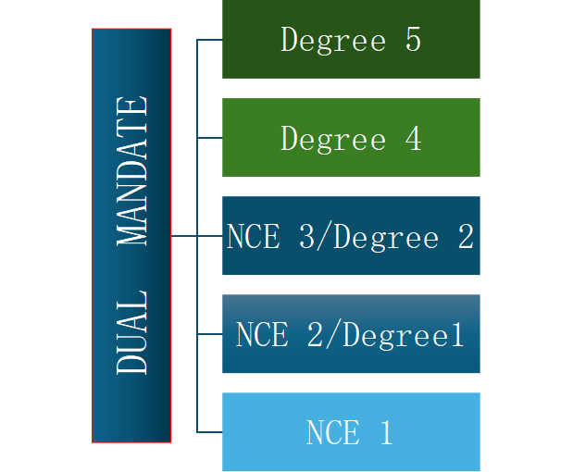
Dual Mandate Structure
A B
Degree 3
Degree 2
Degree 1

Slide 20
Proposed Implementation Models
Model C: Specialization Cluster Model
Colleges focus on distinct subject clusters (e.g., STEM, Arts, Vocational Ed.) to maximize resource efficiency and avoid duplication across the system.

Slide 21
CONCLUSION
The dual mandate offers a generational opportunity to reconfigure teacher education in Nigeria. However, successful implementation demands:
Strong political will and sustainable funding mechanisms.
Institutional commitment to quality assurance. Stakeholder synergy and a phased, flexible model that allows colleges to mature at their own pace.
CONCLUSION
The need for a dual mandate pre-dates contemporary concerns of the COE system, implying that the recognition of the need for status change is not misplaced. Besides the ease of access to tertiary education, the dual mandate promises to provide a seamless avenue for the best professional training for prospective teachers, the effect of which remains invaluable.

Slide 22
RECOMMENDATION
Strengthen inter-agency collaboration.
Institutionalize annual performance review mechanisms through NCCE.
Establish a Dual Mandate Implementation Fund for academic and infrastructural enhancement..
Institutionalize monitoring and evaluation mechanisms.
Promote long-term professional development for educators.
Prioritize quality, relevance, and sustainability in implementation.
Release of the white paper enabling the College.
Engage global development partners to support curriculum and digital transformation.
RECOMMENDATION

Slide 23
References
Federal Colleges of Education (Establishment) Act, 2023.
Federal Ministry of Education (2024). Roadmap for the Education Sector (2024–2027).
COFEP, COEASU, CORECON, SSUCOEN (2024). Draft Implementation Framework for Dual Mandate.
National Policy on Education (2020 Edition).
Sustainable Development Goals (SDG 4).

Slide 24
THANK YOU

