Slide 1
Aligning Individual Goals with Ministry’s Strategy: Cascading SMART goals
MR. ABIODUN AJAYI
+2348035010548
Jacob.ajayi@ohcsf.gov.ng

Slide 2
Learning Objectives
At the end of the session, participants will be able to:
identify the importance of strategic alignment of individual goals to organizational goals;
learn how to categorize deliverables under Presidential Priorities, MDA Operational Goals, and Service-Wide Key Result Areas (KRAs); and
acquire hands-on experience in applying templates and tools for cascading job objectives and performance targets effectively.

Slide 3
Introduction…
Aligning individual goals with the Ministry's strategy is the key to unlocking collective success.
Let's dive into the world of SMART goals and discover how cascading objectives can transform our organization.

Slide 4
Alignment means making sure that everyone is moving in the same direction, towards the same goal.
WHAT IS ALIGNMENT?

Slide 5
YOUR PERSPECTIVE DETERMINES YOUR ALIGNMENT

Slide 6
. To sustainably harness Nigeria's rich transportation system, safety &security, economic growth and development while ensuring the conservation of our public transportation services.
UNDERSTANDING YOUR MISSION & VISION AS A KEY TO ALIGNMENT

Slide 7
Key Components of the PMS Framework
PERFORMANCE MANAGEMENT SYSTEM (PMS)
MINISTERIAL PMS (MPMS)
EMPLOYEE PMS (EPMS)
7

Slide 8
Key Components of the PMS Framework…
Dual Structure of PMS:
Ministerial-Level Performance Management: Focuses on aligning the performance of Ministries, Departments, and Agencies (MDAs) with national priorities, strategic objectives, and service delivery mandates.
Employee-Level Performance Management: Ensures that individual Public Servants have clear expectations, measurable targets, and structured feedback mechanisms to drive personal and professional growth.
8

Slide 9
Boost Agriculture to Achieve Food Security
Reform the Economy to deliver Sustained Inclusive Growth
Strengthen National Security for Peace and Prosperity
Unlock Energy and Natural Resources for Sustainable Development
Enhance Infrastructure and Transportation as Enablers of Growth
Priority Areas
Focus on Education, Health and Social Investment as Essential Pillars of Development
Accelerate Industrialization through Digital Economy, Manufacturing and Innovative Technology
Improve Governance for Effective Service Delivery
13

Slide 10
WHOLE OF GOVERNMENT APPROACH
In the context of the New Performance Management System (PMS), a Whole of Government Approach has been adopted, that involves the integration of performance management processes across all government agencies.
Instead of each agency operating independently, they align their individual performance management systems with overarching government priorities and objectives. The aim is to create a unified, coordinated effort that maximizes efficiency, avoids duplication of efforts, and ensures that the entire government machinery is working towards common goals.
Performance
Management
System
13

Slide 11
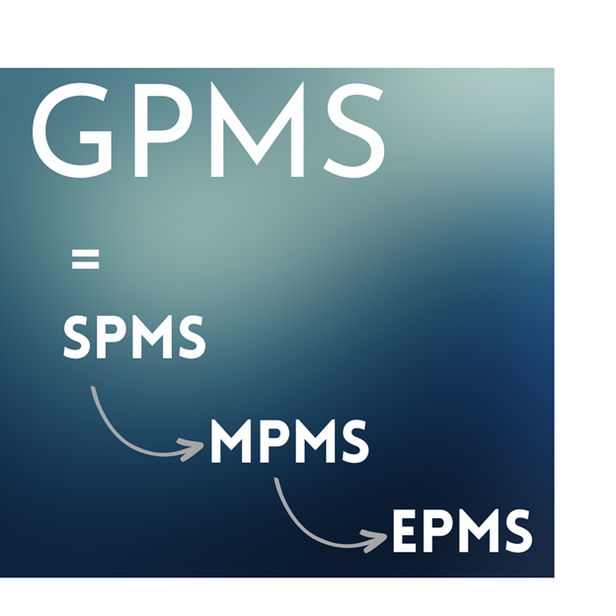
CASCADING…
National Development Goals as prioritized by Government
MDA’s Goals & Objectives
Departments Job Objectives
Division, Branches/Units & Sections Objectives
Departmental
plan
Individual Employee Job Objectives

Slide 12
CASCADING OF DELIVERABLES!
Performance Contracts for each Sector and each MDA shall be finalized at the following Performance Planning Retreats in order to achieve cascading of deliverables
Government prioritized deliverables (38%) are cascaded to the Permanent Secretary (s) and Chief Executives of Agencies and Parastatals in each sector. Contract must be signed between the PS, CEOs and the Honourable Minister (s) at the end of the retreat.
SECTORAL RETREAT
This is the retreat of the PS with all Directors /Heads of Units where deliverables signed by the PS is cascaded to Departments. The aggregation of Presidential Deliverables, Operational and Service Wide KRAs is what is cascaded to all Department in this retreat
MDA RETREAT
Service-wide Retreat
This shall have in attendance the Head of the Civil Service of the Federation and Permanent Secretaries service-wide

Slide 13
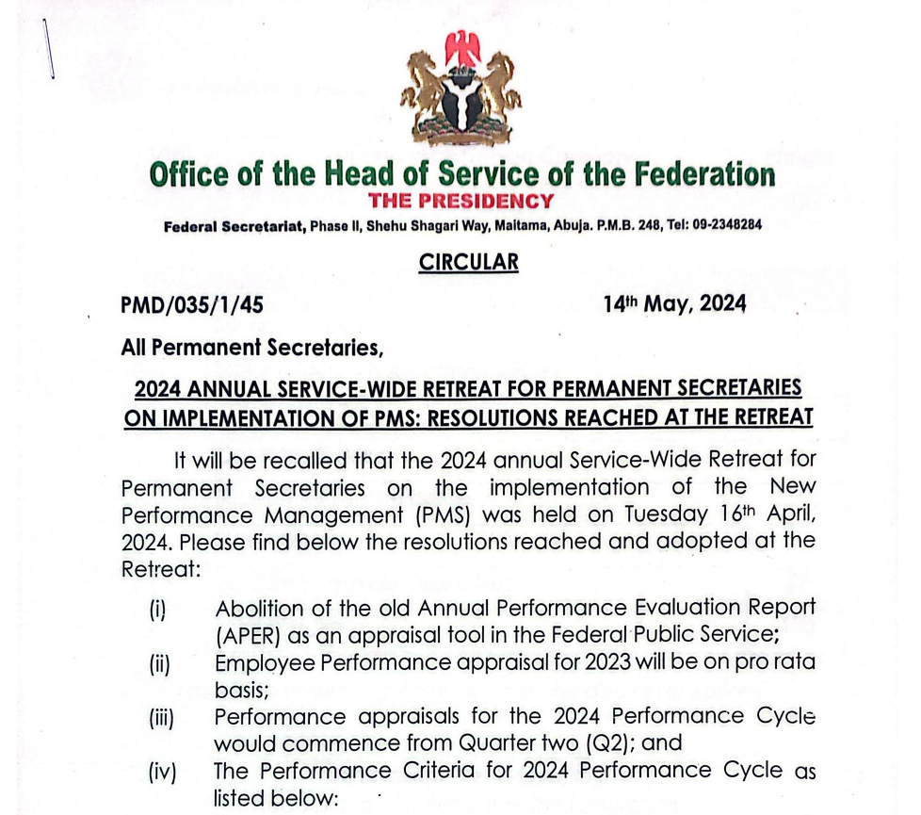

Slide 14
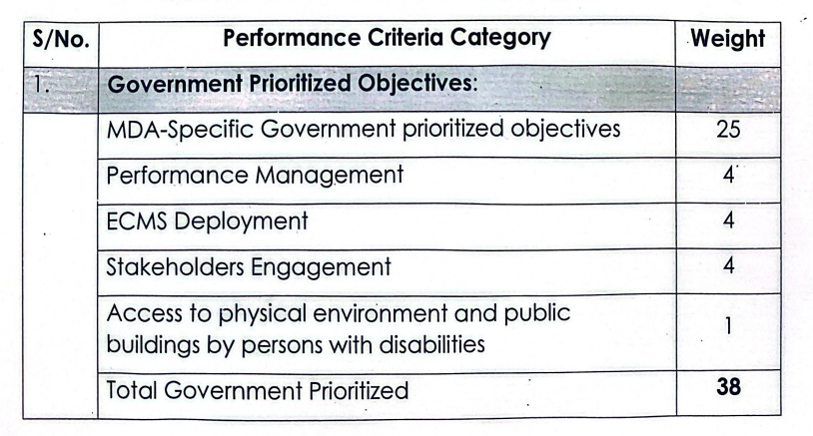

Slide 15
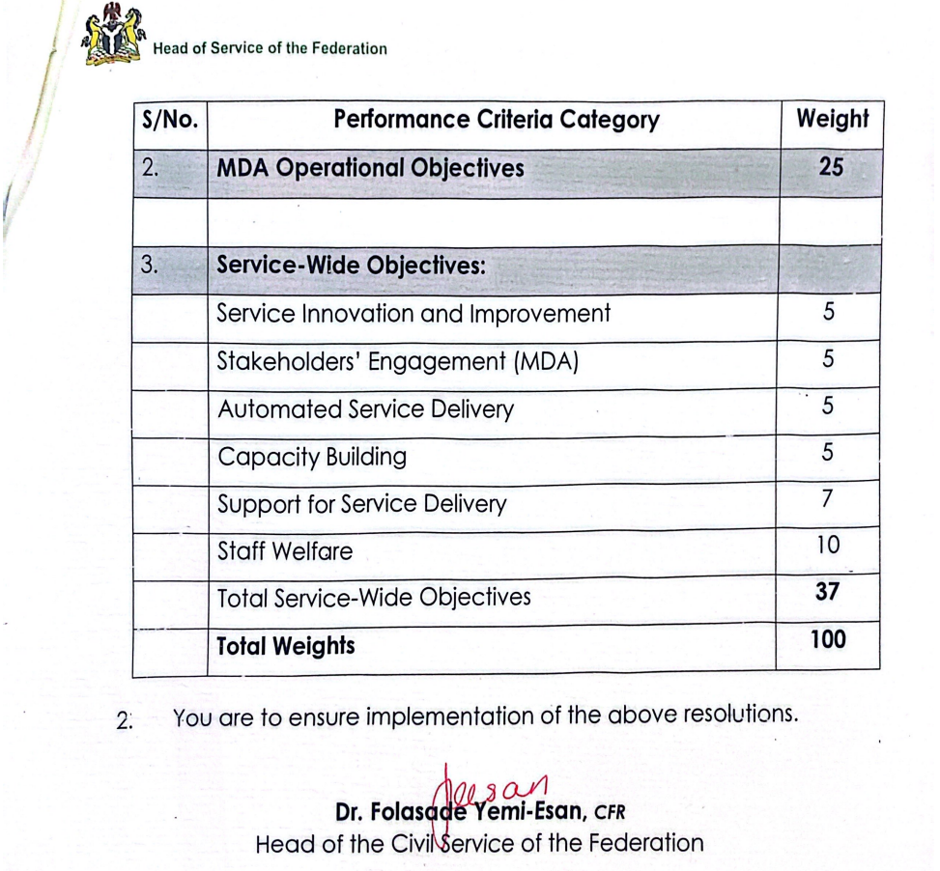

Slide 16
Composition of the institutional performance management
01
02
03
PRESIDENTIAL DELIVERABLES (38%)
OPERATIONAL KRAs (25%)
SERVICE-WIDE KRAs (37%)
Ministerial Performance Management System (MPMS)

Slide 17
IMPORTANCE OF ALIGNMENT AND CASCADING OBJECTIVES
Clarity of Purpose
Performance Measurement
Motivation and Engagement
Resource Allocation
Professional Development
Alignment with Organizational Goals

Slide 18
IMPORTANCE OF JOB OBJECTIVE SETTING
Clarity of Purpose:
Job objectives provide employees with a clear understanding of what is expected of them. This align individuals' efforts with organizational goals, ensuring that everyone is moving in the same direction.
Performance Measurement:
Objectives serve as benchmarks for evaluating performance. Employees and their supervisors can assess progress, identify achievements, and address areas that may need improvement during performance reviews.

Slide 19
IMPORTANCE OF JOB… Cont’d
Motivation and Engagement:
When Staff understand how their work contributes to the overall success of the organization, they are more likely to be engaged and committed to their tasks.
Resource Allocation:
Organizations can allocate time, financial and human resource more effectively when they have a clear understanding of the tasks and goals each role is expected to accomplish.

Slide 20
IMPORTANCE OF JOB… Cont’d
Professional / Career Development:
Job objectives are instrumental in identifying areas for professional growth. When employees know what is expected of them in the short and long term, they can proactively seek opportunities to develop skills and competencies that align with their objectives.
Alignment with Organizational Goals:
Setting job objectives ensures that individual goals align with the broader objectives of the organization. This alignment is crucial for achieving a cohesive and unified effort toward the overall mission and vision of the organization, private or public.

Slide 21
KEY TERMINOLOGIES
21

Slide 22
Key Result Areas (KRAs)
Most important areas of responsibility that an individual needs to focus on to achieve results
Example :
Transportation safety
Infrastructure development
Regulatory framework compliance
Public transportation services
22

Slide 23
Another Example
Improve Governance for Effective Service Delivery in the FMoT
Engage with stakeholders, including the public, transportation operators, and other government agencies ,to ensure that their needs and concerns are addressed.
Implement the personnel performance management system of the Federal government to promote accountability in public service delivery.
develop and implement emergency response plans to ensure effective response to transportation-related emergencied and disasters.
Conduct research and development to improve transportation infrastructure , services,and technologies.
Governance & Service Delivery
Stakeholders Engagement
PMS Implementation
Emergency response and planning
Research and development
23

Slide 24
KEY RESULT AREAs (KRAs)
NOTE
KRAs should be a minimum of 3 and maximum of 7 KRAs for individuals
Data Management and Documentation
Training and Development
Approvals
Policy Development
Quality Assurance
Voucher Preparation

Slide 25
OBJECTIVES
Used to define the specific outcomes that individuals or teams are responsible for achieving within a given time period
When writing objectives, use action-oriented Verbs which describe what needs to be done to achieve the objectives. e.g Prepare, review, coordinate etc

Slide 26
SMART OBJECTIVES
Specific – outline in a clear statement precisely what is required.
Measurable – include a measure to enable organisations to monitor progress and to know when the objective has been achieved.
Achievable (or agreed) - objectives should be agreed by Managers and Employees to ensure commitment to them and also take responsibility for them
Realistic (or relevant) - focus on outcomes, rather than the means of achieving them
Time-bound (or time-bound) – agree the date by which the outcome must be achieved

Slide 27
SMART OBJECTIVES:
SMART OBJECTIVEby S
Achieve 100% compliance with regulatory standards in Railway Security and Safety in Nigeria by 31st December, 2025 in line with international best practice.
Train all Directorate Level Officers in the FMoT on the new Performance Management System by 30th November, 2025.

Slide 28
KEY PERFORMANCE INDICATORS (KPIs):
A KPI is a measurable value that demonstrates how effectively you express what you want to achieve and by when.
KPIs start with $ = Value of
# = Number of
% = Percentage of
= yes or no
# of days to fill a vacancy
% of eligible employees who receive promotions
% of employees who report satisfaction with the disciplinary process

Slide 29
Key Performance Indicators (KPIs)
Metrics: Anything you can measure
Key Performance Indicators- quantifiable, outcome-based statements used to measure achievement of objectives.
The operative word in KPI is “Key” because every KPI should be related to a specific outcome with a performance measure.
COUNT!
29

Slide 30
KPIs Measures
Quantity
Quality
Cost Vs Budget
Health & Safety Standards
Risk

Slide 31
EXAMPLES OF KEY PERFORMANCE INDICATORS (KPIs)
Number of accidents per thousand passengers trip.
Number of Stakeholder engagements held
Percentage available infrastructure capacity used
Percentage of staff trained on the implementation of the new PMS
Number of reported crimes per thousand passengers trips.
31

Slide 32
TARGET
Target: the desired result you wish to achieve in relation to a KPI
32

Slide 33
RECAP
Objectives
start with
KPIs
start with
Target
are
KRAs
start with
Noun
Verb
$ = Value of
Figures
# = Number of
% = Percentage of
Stakeholder Management
Increase Stakeholder Satisfaction Index
$ Internal generated revenue
N 1.5m
# Complaints resolved # Days to resolve complaints
228 Complaints
60 Days
% Stakeholder Satisfaction over prior Year
5%
33

Slide 34
TEMPLATE
Performance Management System
Enterprise Content Management
Stakeholder Engagement
People living with Disability (inclusivity)
STANDARDISATION

Slide 37
LAST LINE
By fostering alignment with PMS Tools and implementation Framework, FMoT can effectively translate its strategic goals into actionable and measurable outcomes at all levels of accountabilities.

